Slide 1
DN1 ATAC-seq
Veronica

Slide 2

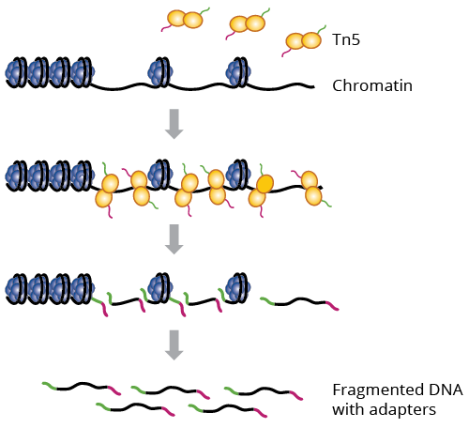
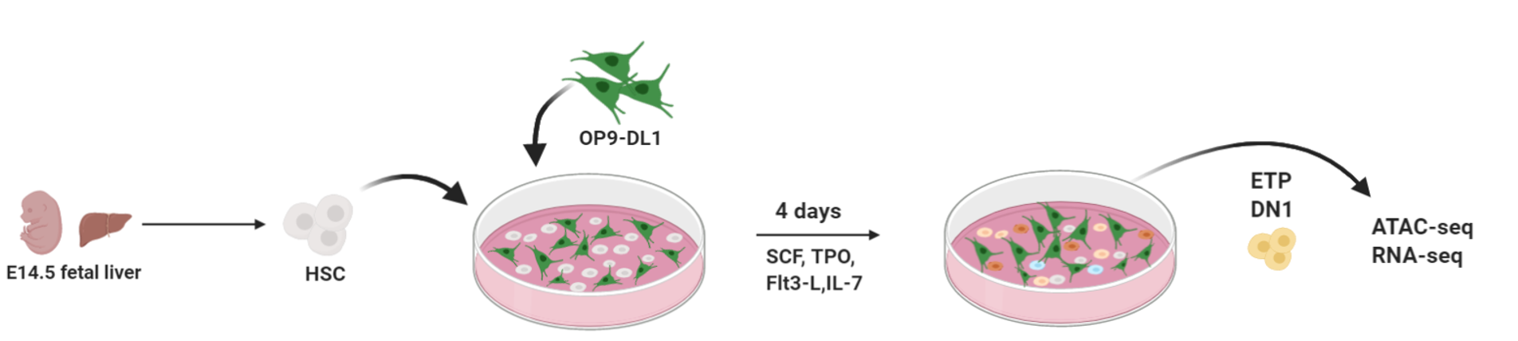
Background
?
?
Block identified with:
- FACS
- scRNA-seq
Morc3

Slide 3
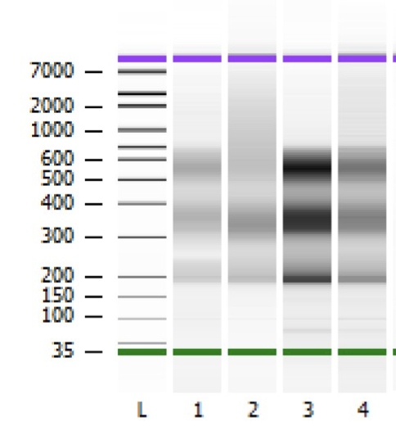
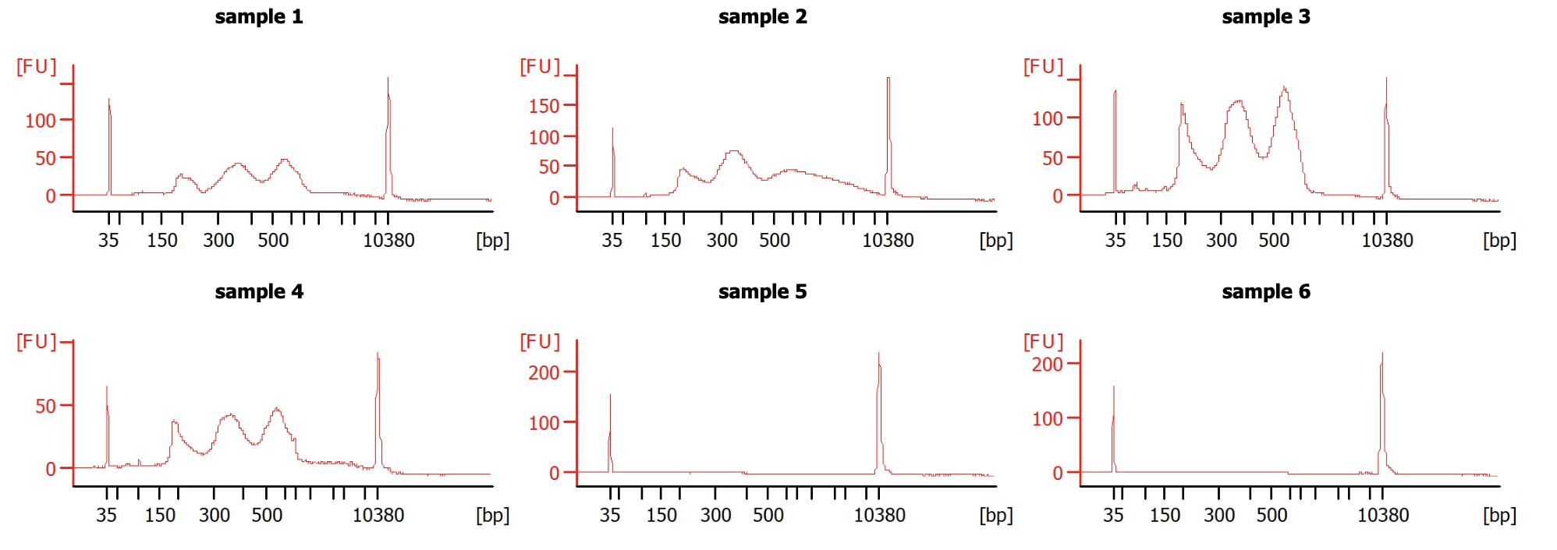
50000 DN1 cells from OP9:
2 x WT
2 x KO

Slide 4
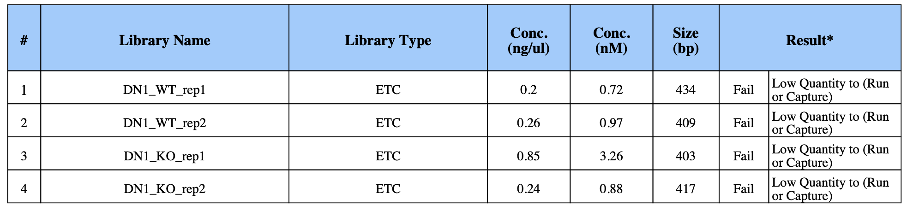
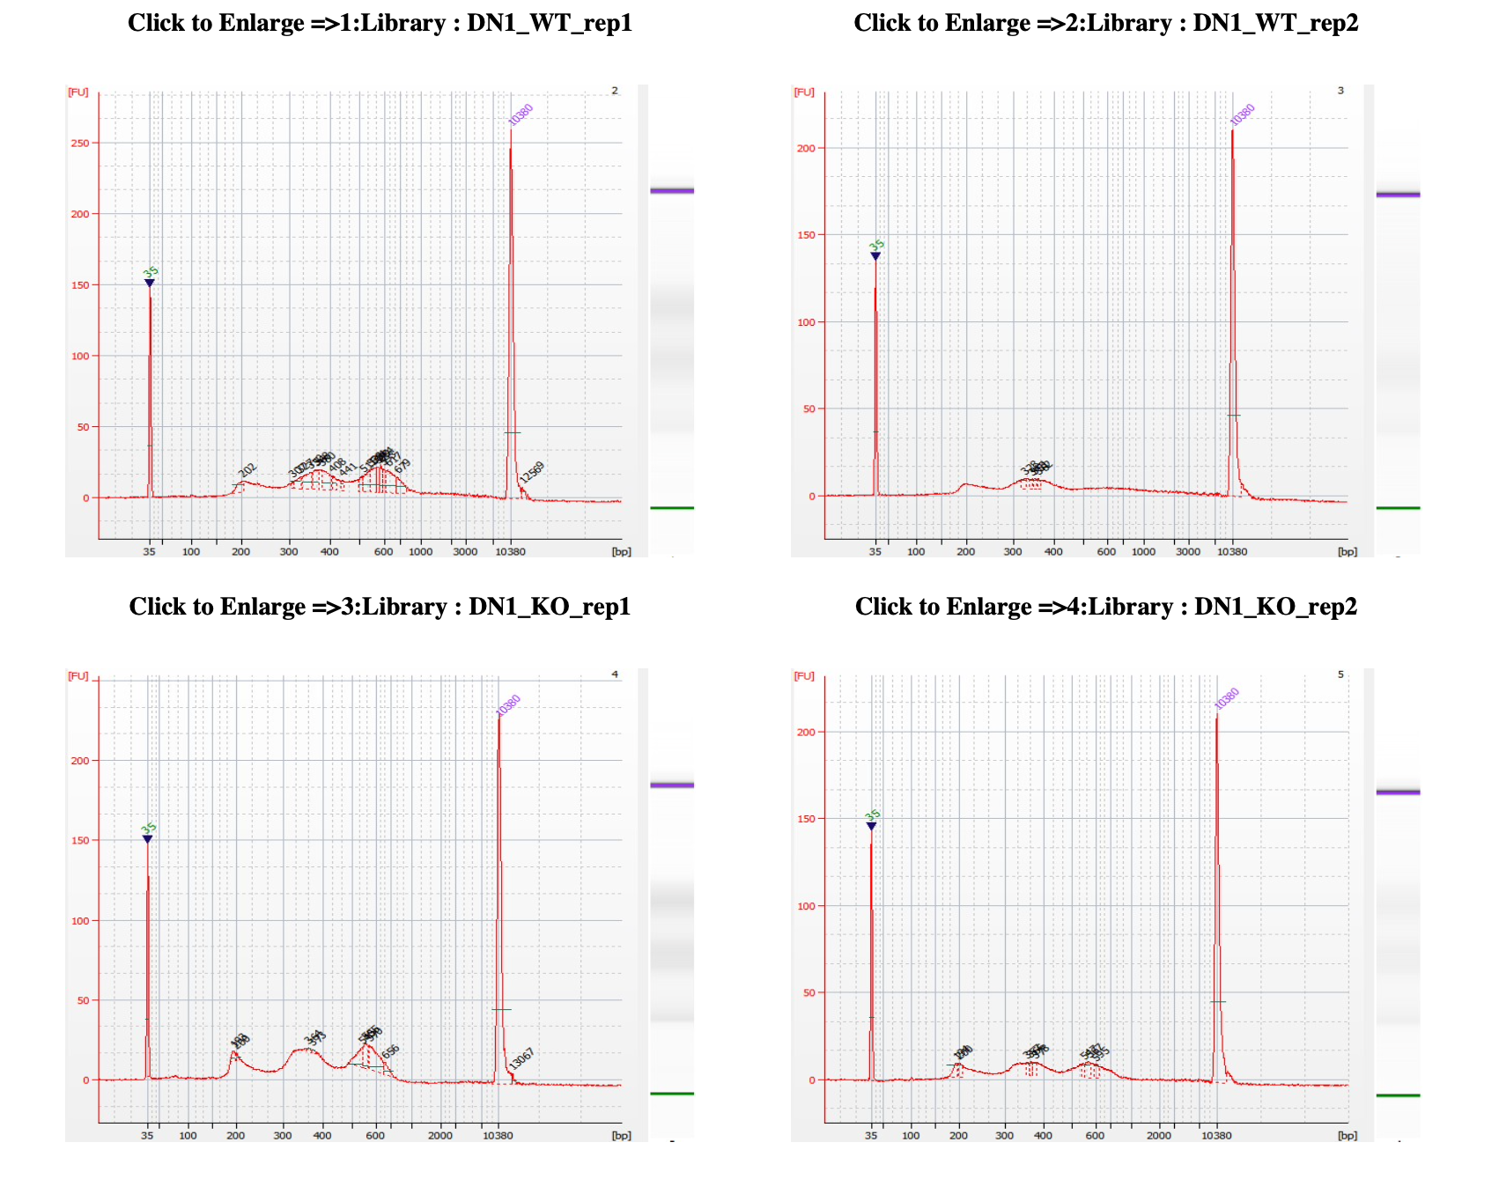

Slide 5
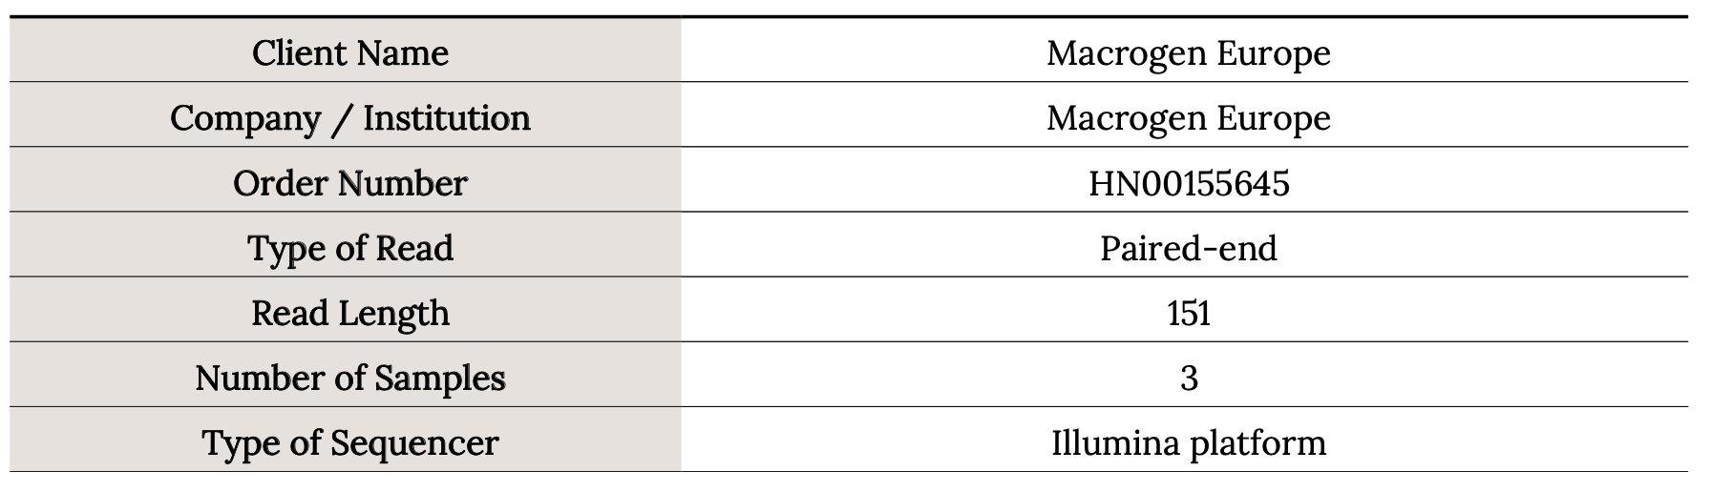
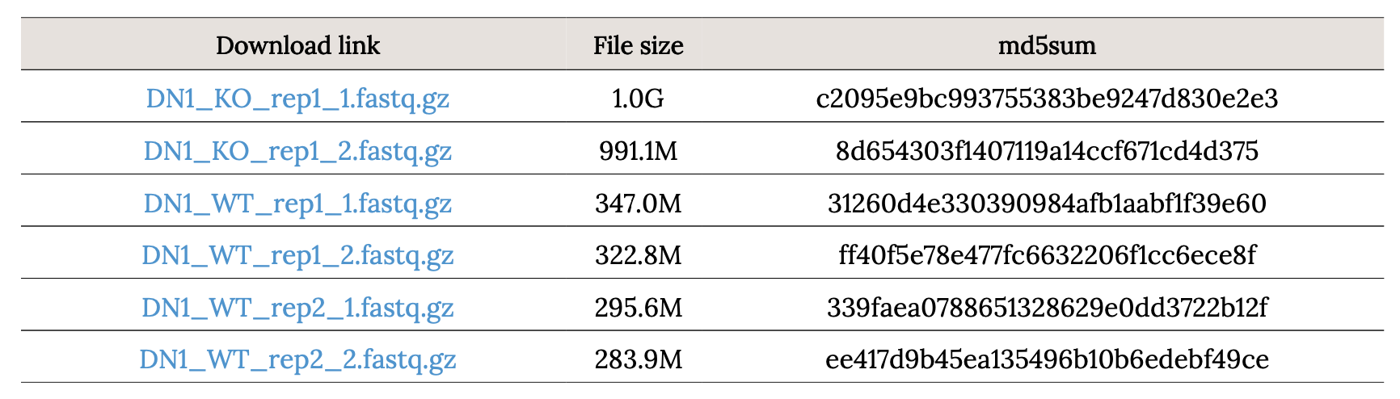
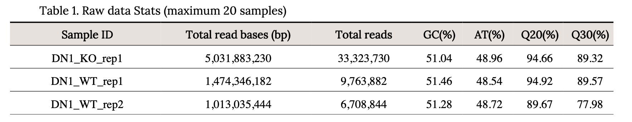
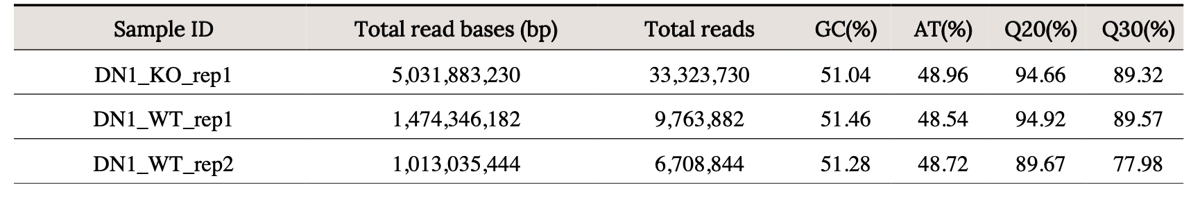
QC reports provided by Macrogen

Slide 6
Analysis
Done with our Snakemake-ATAC-seq pipeline

Slide 7
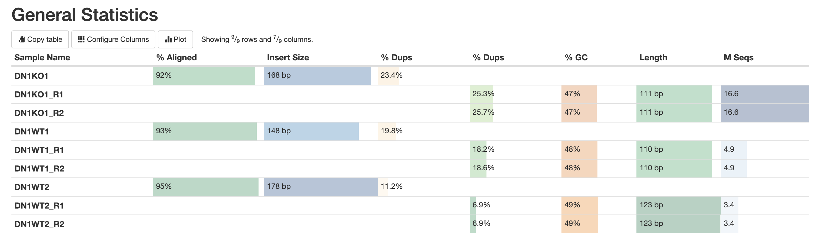
Quality controls

Slide 8
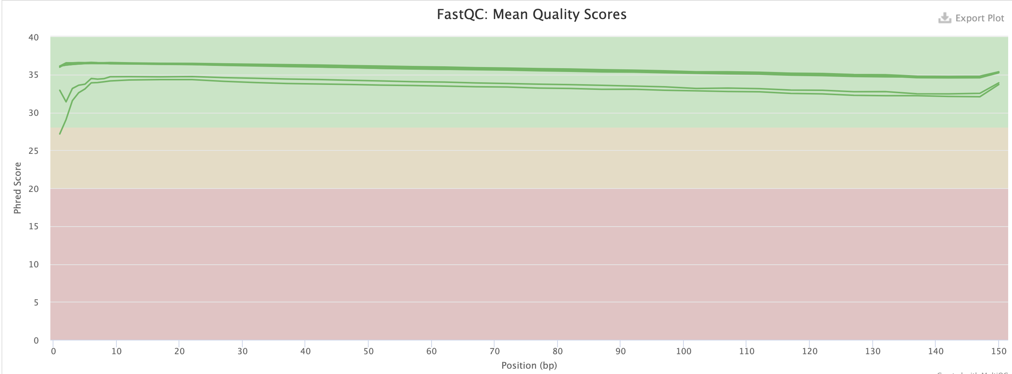
Quality controls

Slide 9
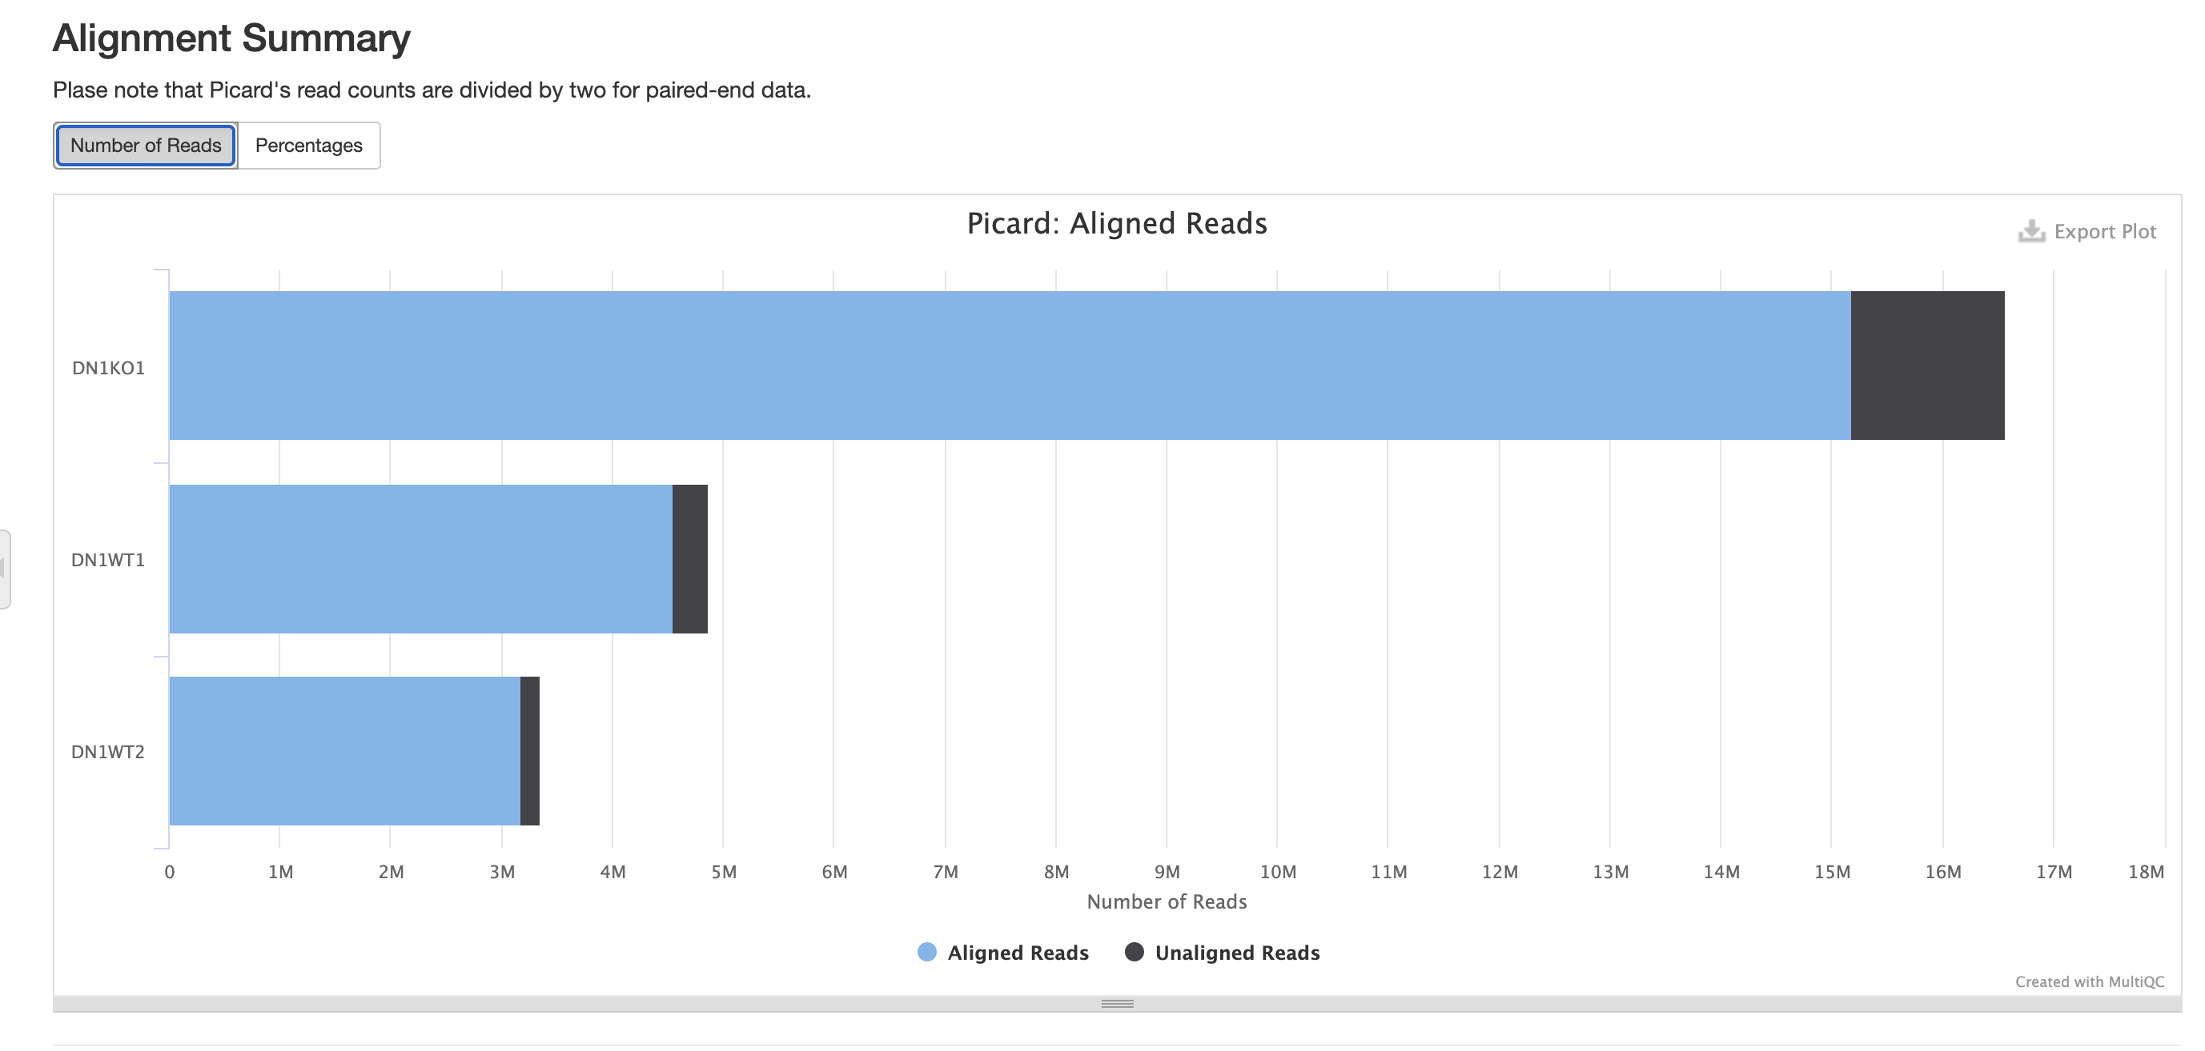
Quality controls

Slide 10
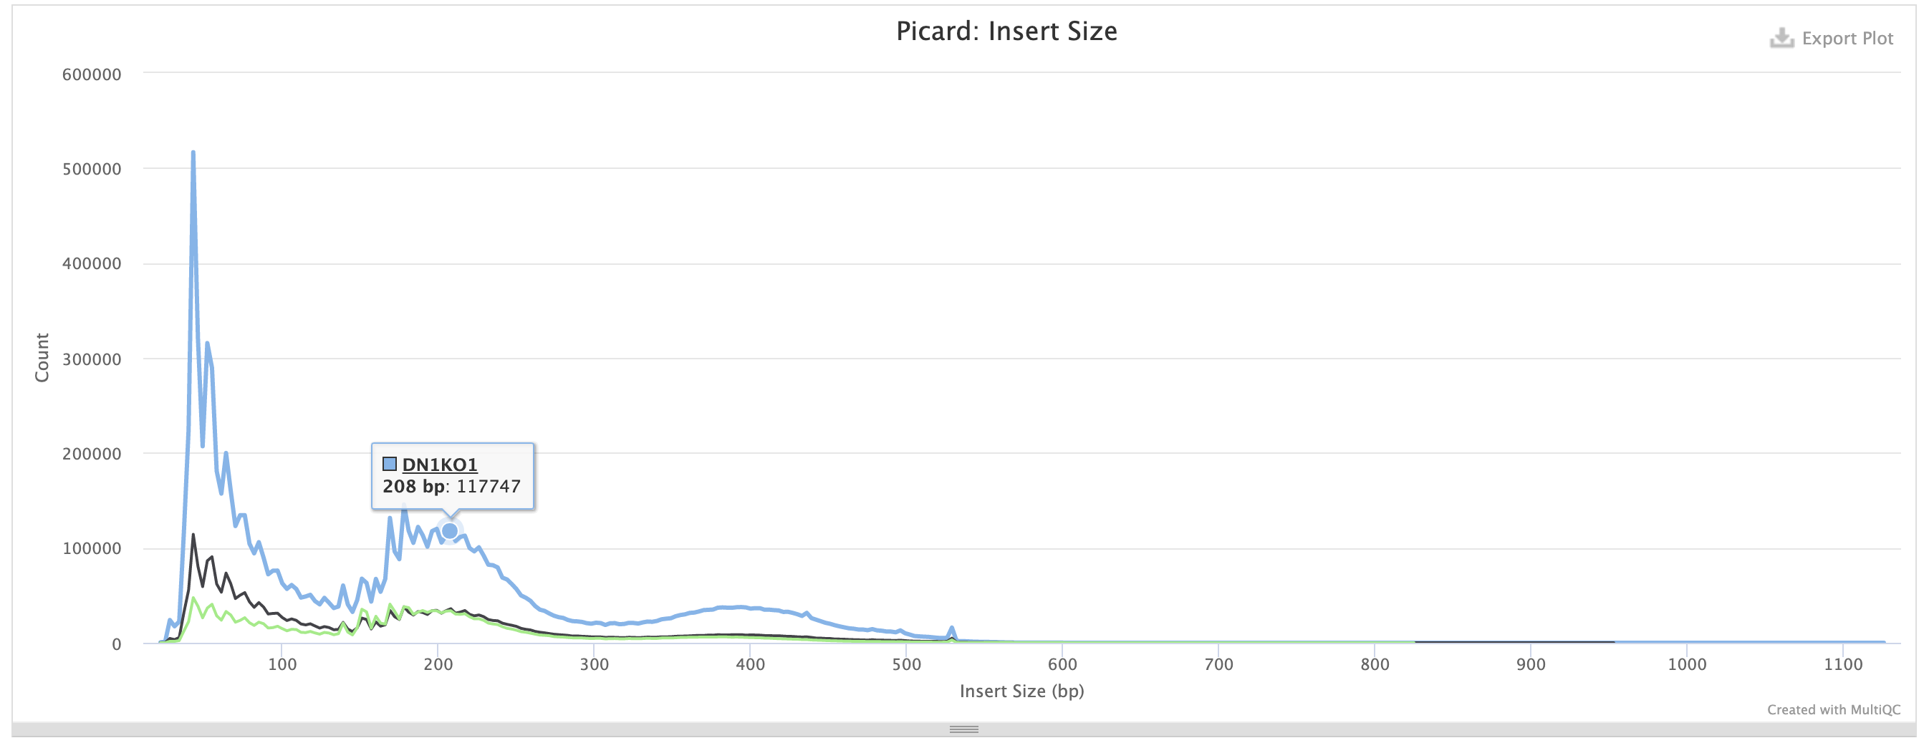

Slide 11
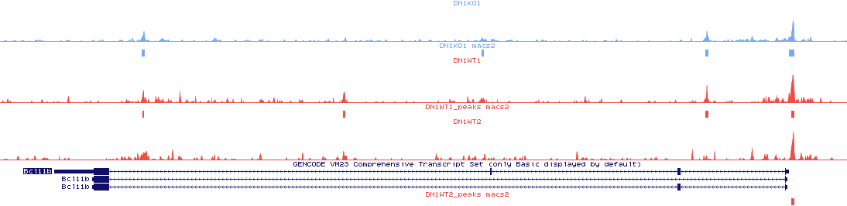
Bcl11b
500
KO
0
500
WT
0
500
WT
0
Promoter

Slide 12
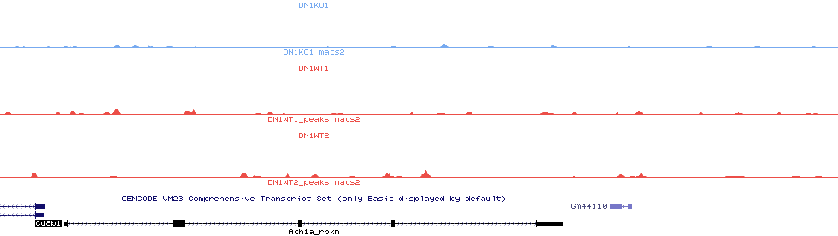
Cd8b1
500
KO
0
500
WT
0
500
WT
0

Slide 13
Peak calling: MACS2
37473
28992
24902

Slide 14
Overlap WT1 and WT2
63% of WT1 peaks overlap
with WT2
73% of WT2 peaks overlap
with WT1

Slide 15
Differential peak analysis
2xWT versus 1xKO
Homer getDifferentialPeaks FC > 4 / p-value <0.05
Relative to WT:
Average size less accessible peaks: 320bp (SD=113bp)
Average size more accessible peaks: 284bp (SD=145bp)

Slide 16


2x DN1 analyzed
99% Aligned reads (10M reads)
Phred > 35
Samples | Peaks
ImmgenWT1 | 58066
ImmgenWT2 | 42862

Slide 17
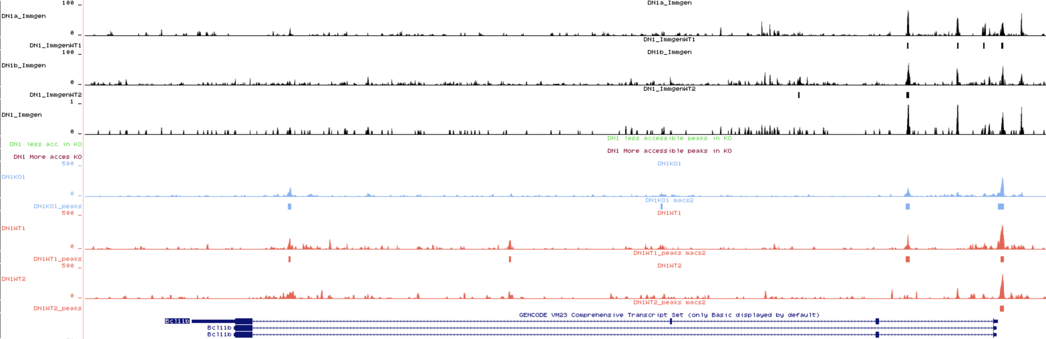
Bcl11b

Slide 18
Overlap Immgen Replicates
64% of WT1 overlaps with WT2
88% of WT2 overlaps with WT1

Slide 19
Overlap Immgen and OP9 peaks
DN1 peaks OP9 co-culture
DN1 peaks Immgen
40% of Immgen peaks overlap with the OP9 DN1 peaks
81% of OP9 peaks overlap with the Immgen peaks
The OP9 ATAC-seq detects less peaks than the Immgen DN1 but most of them are overlap. With our dataset we might be missing some change in accessibility at certain loci.

Slide 20
Number of Peaks
2046
Motif analysis
269
37473
28992
24902
58065
Differential peaks are mostly found away from the gene promoters
42861

Slide 21
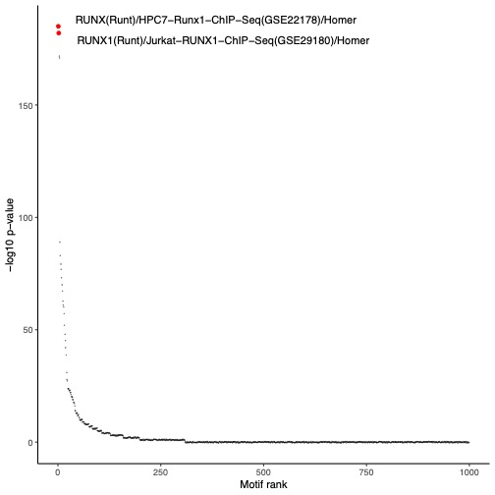
2046 LESS accessible loci in the mutant compared to the WT

Slide 22
269 MORE accessible loci in the mutant compared to the WT

Slide 23
Runx1 motif: CWAACCACAR
Occurrence genome-wide :85689
Overlap with Less accessible peaks: 338 (17%)
Runx1 Motif less accessible (338)
Runx1 Motif less random loci
Runx1 motif are more accessible in WT than in mutant. Also true from Immgen

Slide 24
Tcf7 motif: CCACATCAAAGG
Occurrence genome-wide : 70110
Overlap with Less accessible peaks: 197 (10%)
Tcf7 Motif less accessible (197)
Tcf7 Motif less random

Slide 25
Summary
Despite low coverage, we can identify accessible chromatin in OP-9 ATAC-seq
Most peaks identified are located in promoter region
Identification of Differentially accessible loci (DALs):
2046 are less accessible in the mutant than in WT
269 are more accessible in the mutant than in WT
The motif analysis shows that potential binding sites for important TF regulators of T-cell commitment are impacted
Are those DALs enhancers?
To do: Differential peak analysis between WT OP9 and WT Immgen.

Slide 26
Analysis of coverage at TEs Coverage at LTR
Coverage at LTR does not change between WT and KO
Both are lowly covered with ATAC-seq reads.

Slide 27
Analysis of coverage at TEs Coverage at LINE
Coverage does not change between WT and KO
Both are lowly covered with ATAC-seq reads.

Slide 28
Analysis of coverage at TEs Coverage at SINE
Coverage does not change between WT and KO
Both are lowly covered with ATAC-seq reads.

Slide 29
Analysis of coverage at TEs Coverage at MERVL
Coverage does not change between WT and KO
Both are lowly covered with ATAC-seq reads.

Slide 30
Analysis of coverage at TEs Coverage at ERV1
Coverage does not change between WT and KO
Both are lowly covered with ATAC-seq reads.

Slide 31
Analysis of coverage at TEs Coverage at ERVK
Coverage does not change between WT and KO
Both are lowly covered with ATAC-seq reads.

Slide 32
Analysis of coverage at TEs Coverage at IAP
Coverage does not change between WT and KO
Both are lowly covered with ATAC-seq reads.

Slide 33
Analysis of coverage at TEs Coverage at ERVL
Coverage does not change between WT and KO
Both are lowly covered with ATAC-seq reads.
ERVL show a slight coverage of accessibility in the center of the element

Slide 34
Does Morc3 affect chromatin accessibility in thymus development?

Slide 35
Results DN1 ATAC-seq July 2021
Sequenced 2xWT and 1x mutant
Despite low coverage, we can identify accessible chromatin in OP-9 ATAC-seq
Most peaks identified are in promoter region

Slide 36
Results DN1 ATAC-seq July 2021
Tcf7 motif: CCACATCAAAGG
Occurrence genome-wide : 70110
Overlap with Less accessible peaks: 197 (10%)
Identification of Differentially accessible loci (DALs):
2046 are less accessible in the mutant than in WT
269 are more accessible in the mutant than in WT
The motif analysis shows that potential binding sites for important TF regulators of T-cell commitment are impacted
E.g Specific Tcf7 potential binding sites are less accessible in Morc3 mutant than in WT at DN1 (Similar for Runx1)

Slide 37
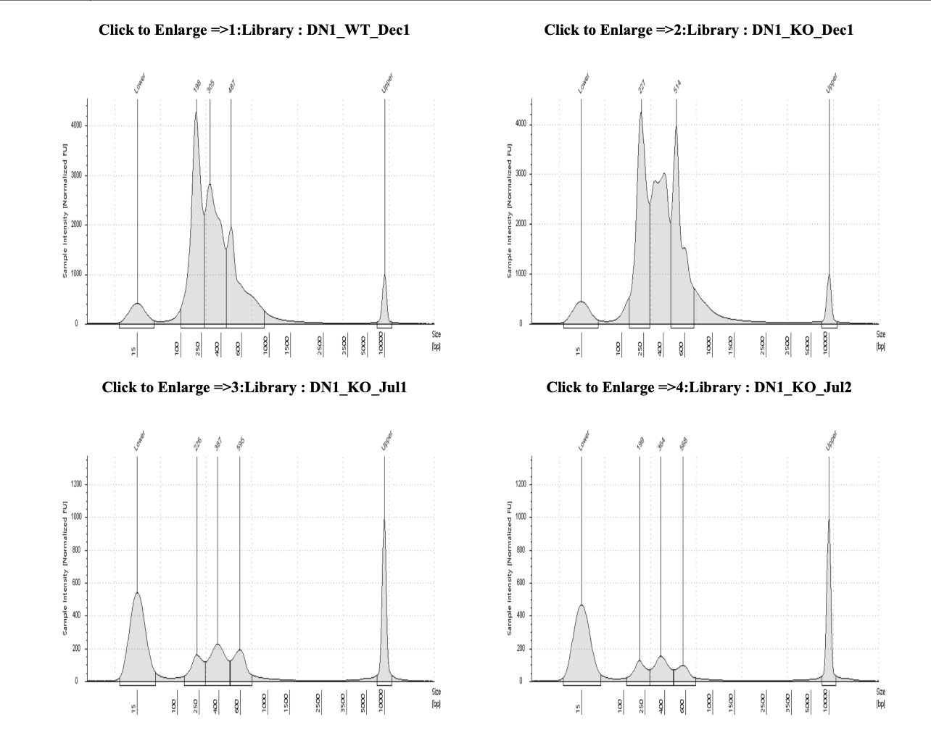
Overview DN1 ATAC 2nd experiment
150bp
PE sequencing
Macrogen

Slide 38
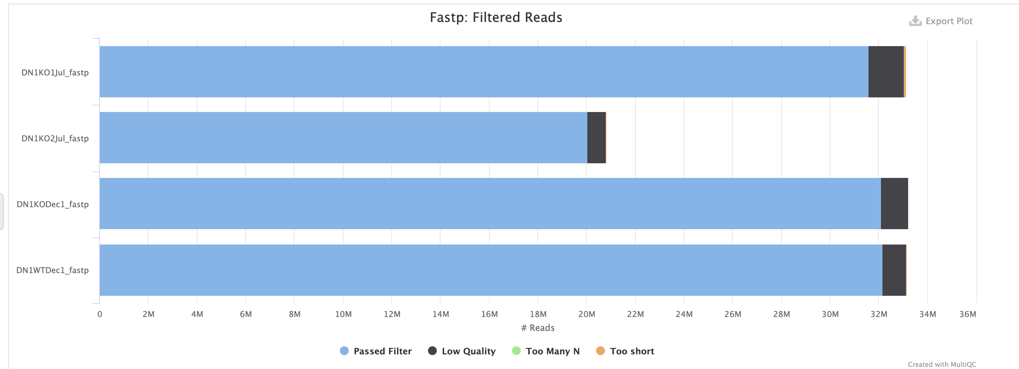
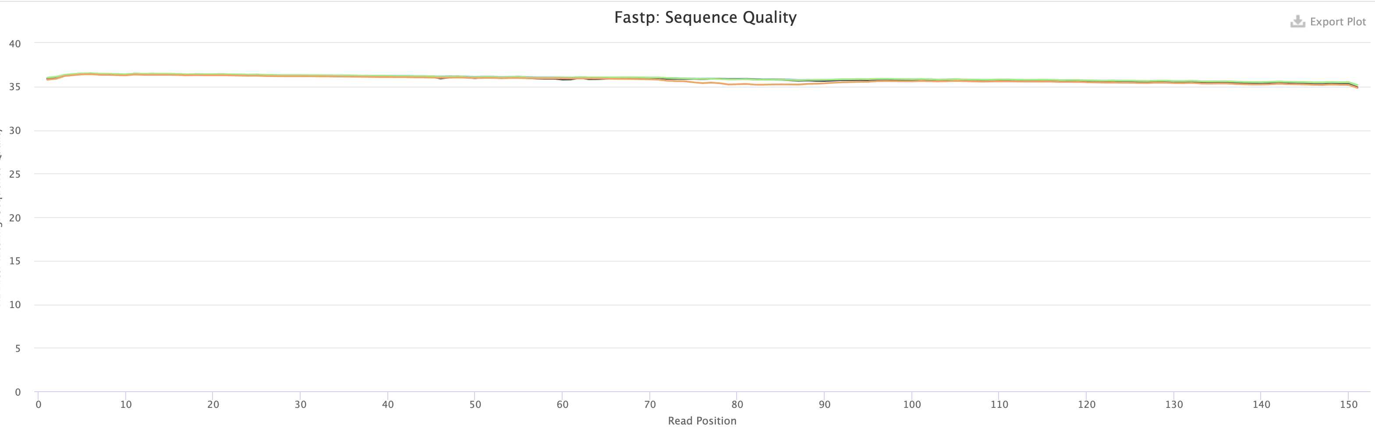

Slide 39
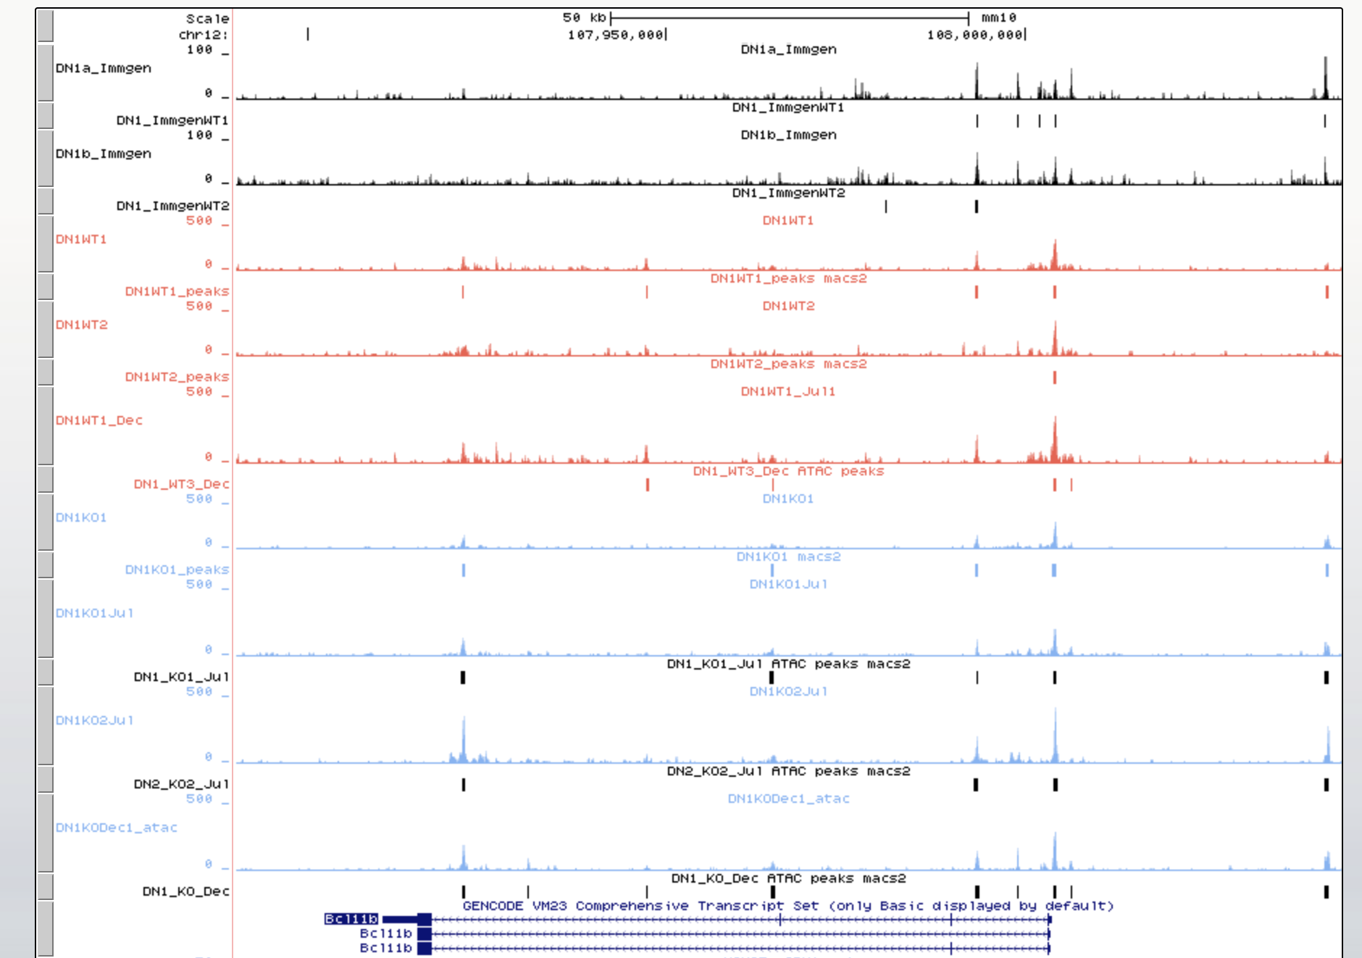
Bcl11b

Slide 40
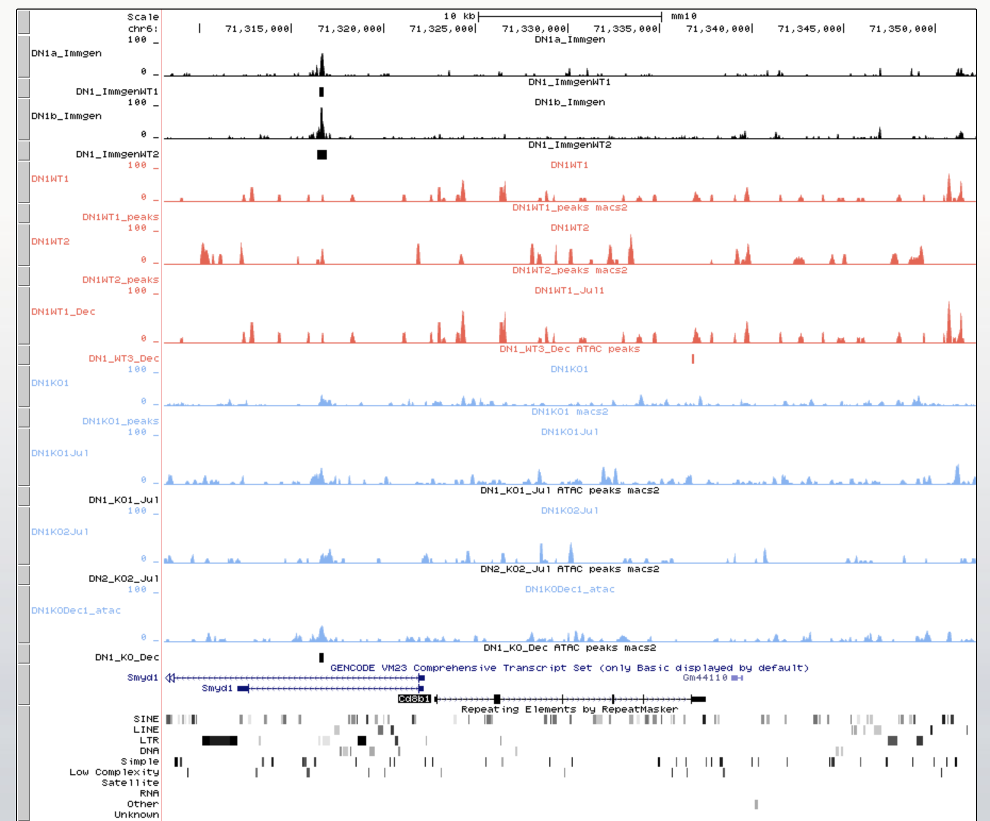
Cd8b1

Slide 41
Annotation peaks DN1 ATAC Dec 2021
76930
45832
49211
46140
With a higher coverage we detect more peaks.
Peaks are mostly at promoters or distal intergenic regions

Slide 42
The ATAC-seq of december get many peaks that were not detected previously
I have the coordinates of those peaks and can annotate them.

Slide 43
The ATAC-seq of december get many peaks that were not detected previously
I have the coordinates of those peaks and can annotate them.

Slide 44
Male
Female

Slide 46
Annotation of the peaks identified for ATAC DN1
74870 peaks
44578 peaks
37436 peaks
47935 peaks
44699 peaks
28288 peaks
24902 peaks

Slide 47
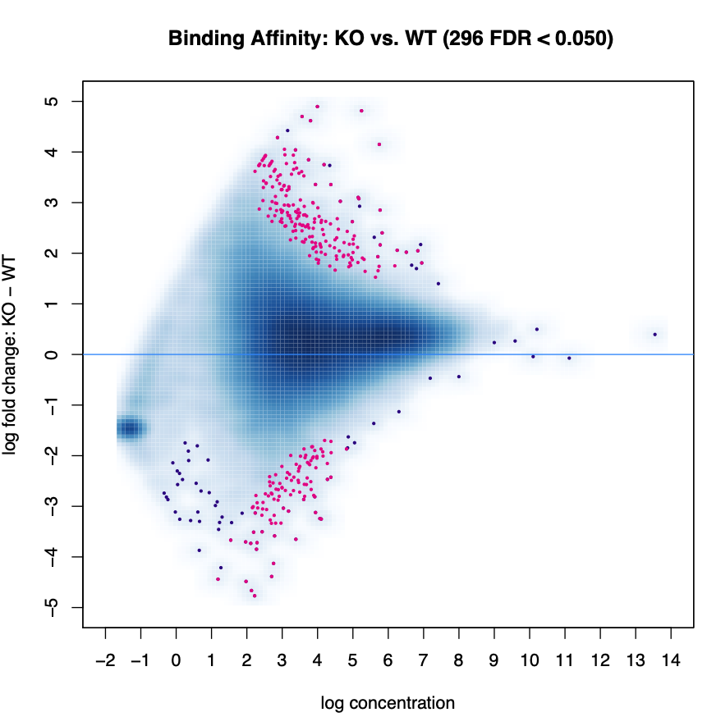
Differential peak analysis
Peaks
3x WT
4x KO
Diffbind
DeSeq2
Padj-value <0,05
Visualization
Heatmap
More accessible in KO
(194)
Less accessible in KO
(103)
Across 7 samples, it measured the difference of accessibility at 58465 peaks. There were found in common in at least 1 WT and 1 KO sample

Slide 48
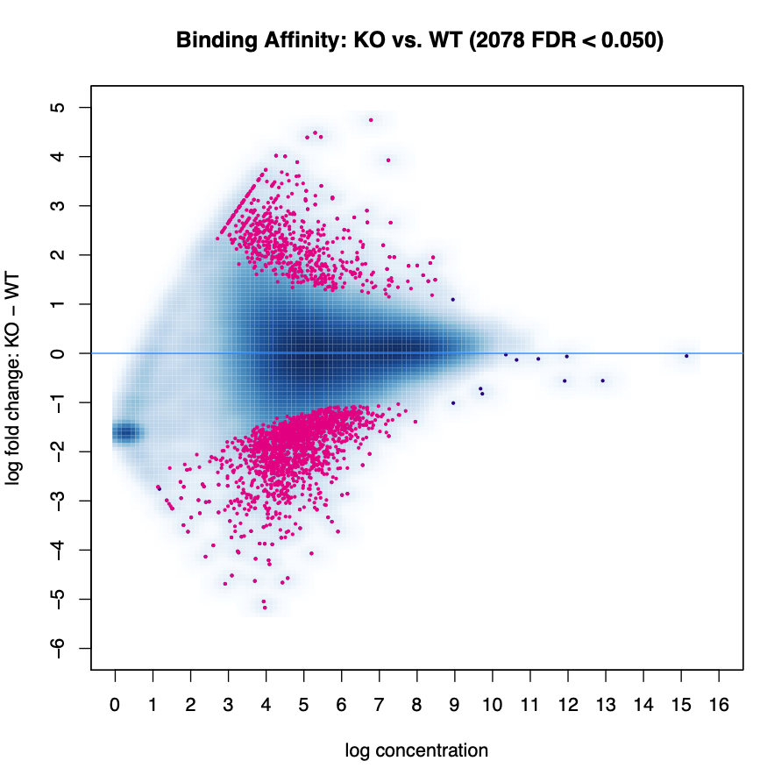
Differential peak analysis
Peaks
3x WT
4x KO
Diffbind
EdgeR
Padj-value <0,05
Visualization
Heatmap
More accessible in KO
Less accessible in KO
As usual EdgeR is less constraining than DESEQ2 for differential peak analysis. We usually choose DESEQ2.

Slide 49
Most peaks that are more accessible in the KO are also accessible in the WT
More accessible peaks in KO
(194)
Less accessible peaks in KO
(103)
Less accessible peaks seem consistent between replicates

Slide 50
103 peaks
194 peaks
74870 peaks
44578 peaks
37436 peaks
Most difference in accessbility between mutant and WT occur in the distal intergenic region and introns.
The differences are smaller than with the previous set of samples
47935 peaks
44699 peaks
28288 peaks
24902 peaks

Slide 51
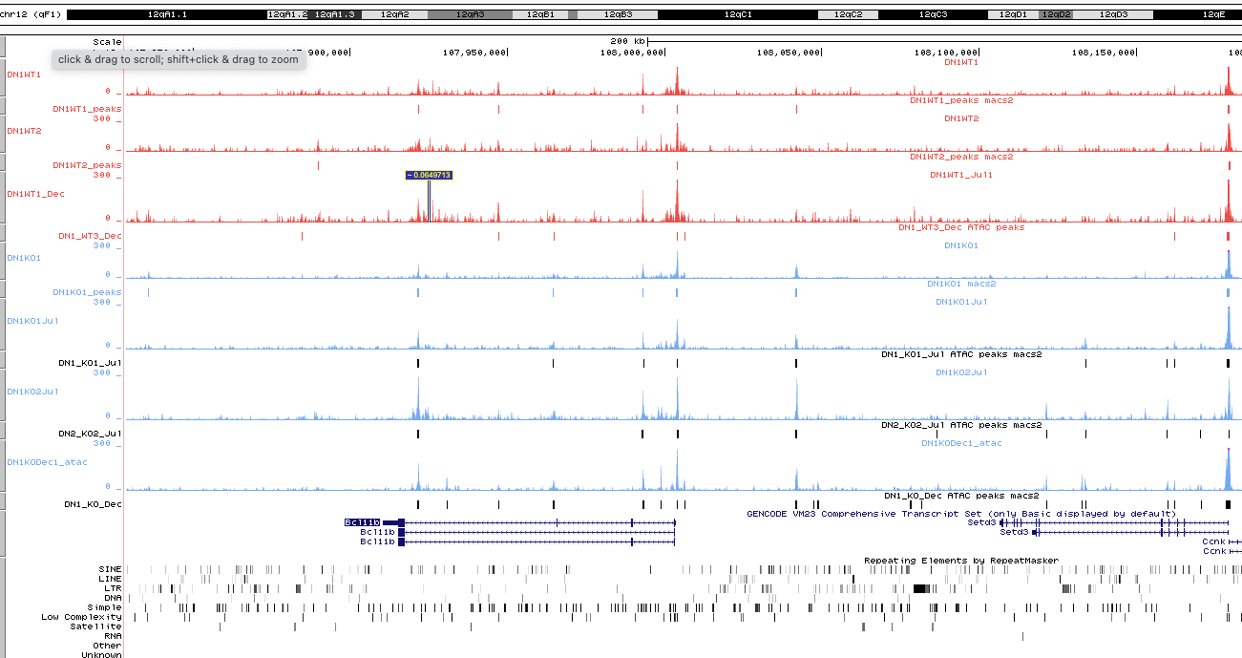
Bcl11b possess an more accessible loci upstream of the promoter in the KO

Slide 52
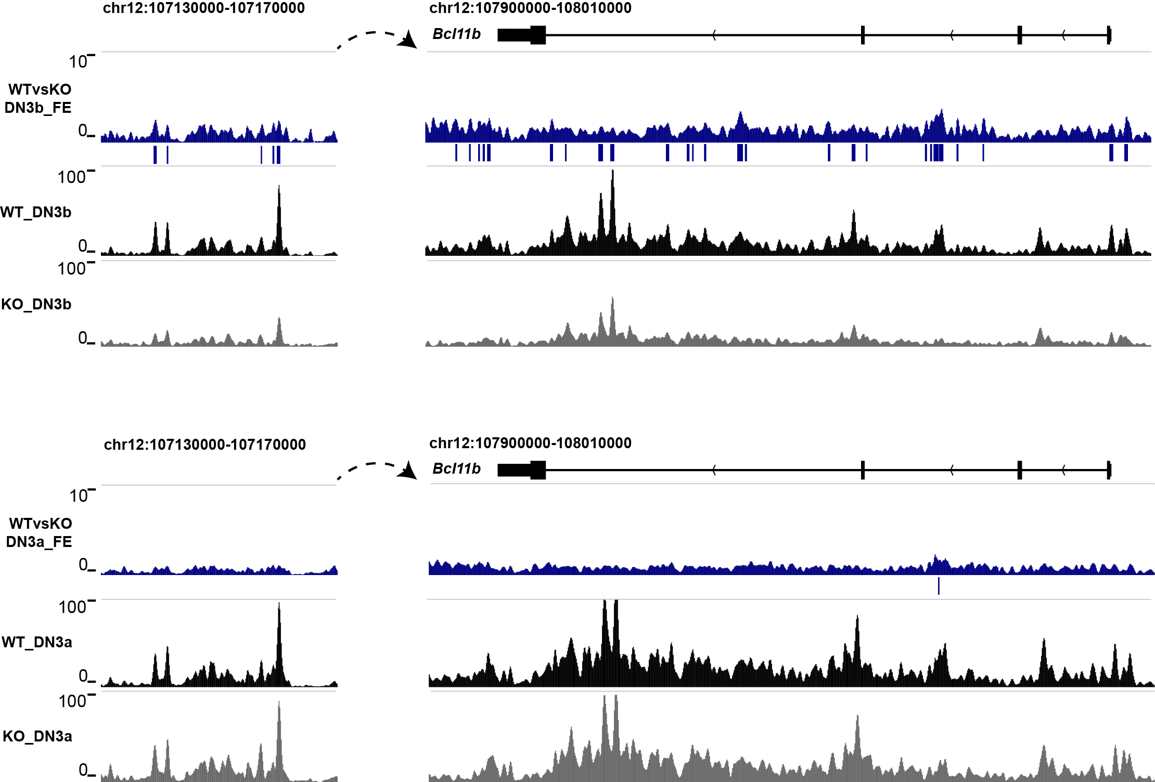
ATAC-seq (Bcl11b)
Fig: ATAC-seq tracks in Bcl11b gene locus and predicted enhancer which is about 800kb downstream of Bcl11b, black and gray tracks are from normalized combined WT and KO(DN3b on the top and DN3a at the bottom) datasets. Blue tracks shows the Fold Enrichment(FE) comparing WT to KO. Blue bars show the peaks called by MACS2 using WT against KO dataset.
More open chromatin state is found from WT DN3b compared to KO in both gene body region and predicted enhancer locus, but there is no change from DN3a.

Slide 53
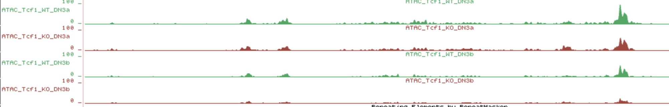
chr12:107,130,001-107,170,000
As Hoayu showed, the Bcl11b enhancer has less accessibility in Tcf1 KO at DN3b stage
The differential peak I identified using homer is not the same as the known enhancer.

Slide 54
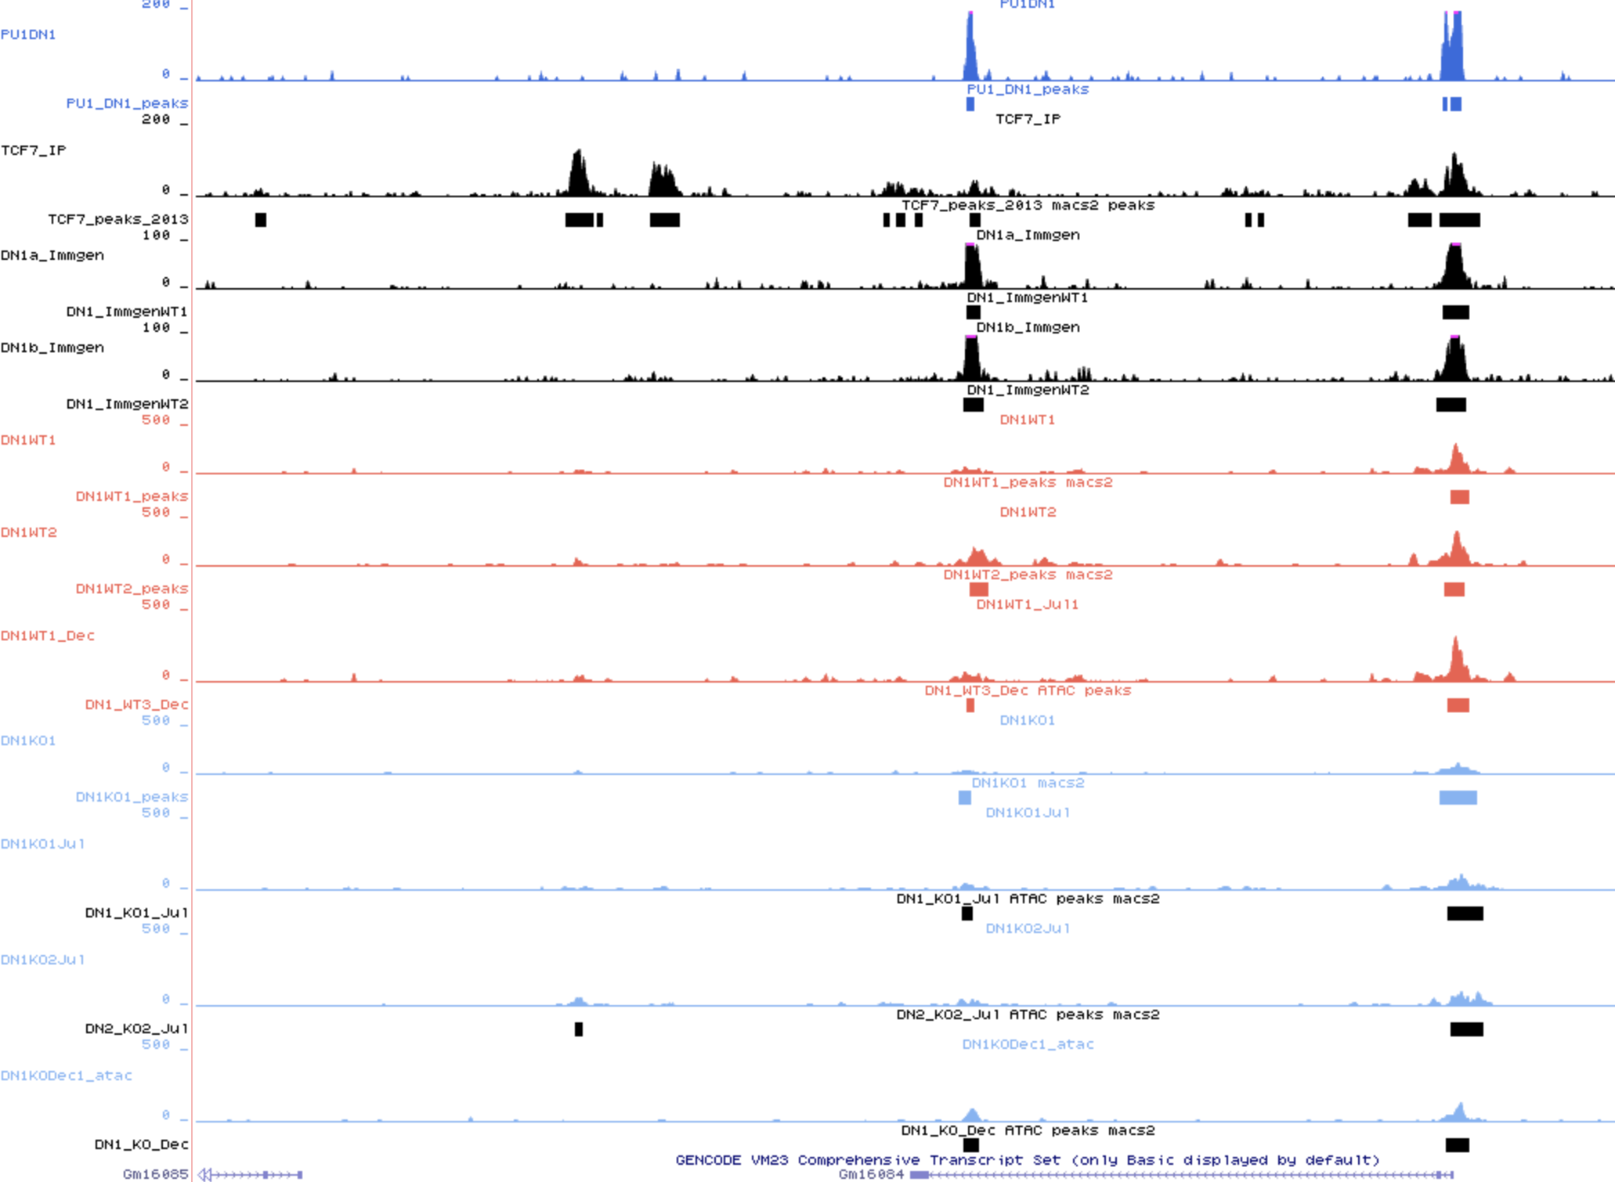
Bcl11b known enhancer seems to be less accessible at DN1 in the MORC3 KO samples

Slide 55
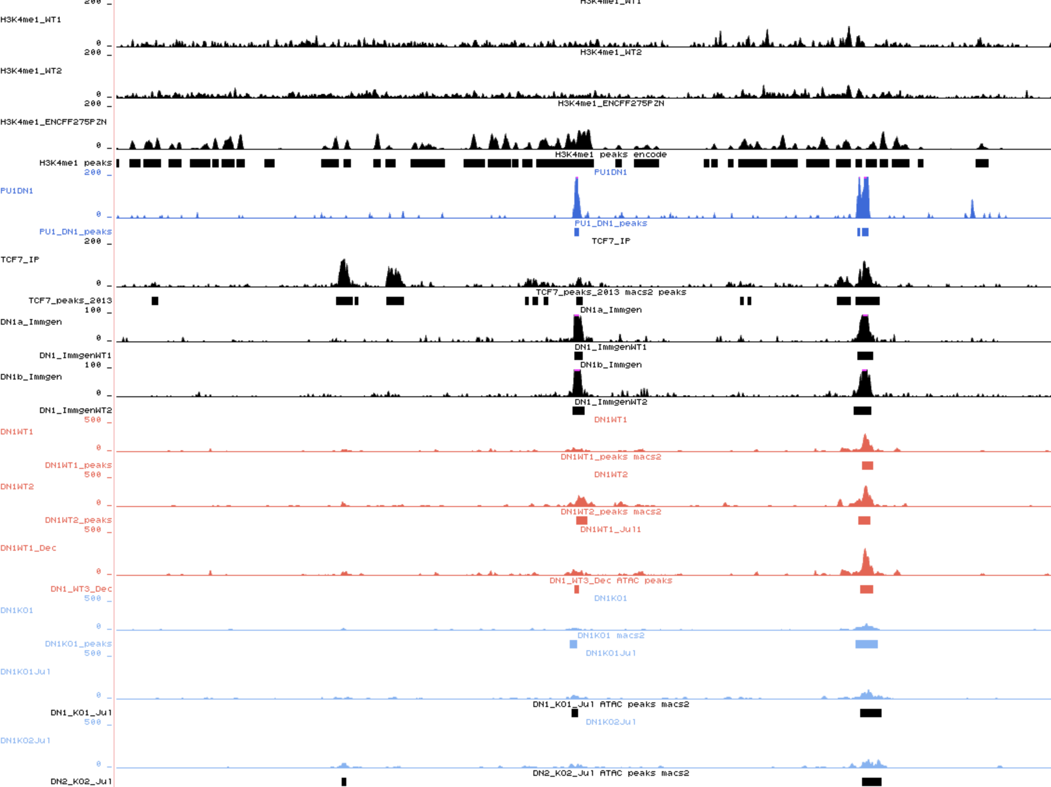
H3K4me1 ChIP-seq in thymus
We do not observe a clear H3K4me1 peak at the known enhancer.
Need to produce the H3K4me1 ChIP-seq at DN1 to confirm or infirm the enhancer.

Slide 56
What is next? (Observation on 18/01/22)
Chromatin accessibility at promoter (Running)
Identify motifs linked to differential accessible loci?
Are T-cell regulators TF motifs still present with our new set of samples?
Check the accessibility at TE
There were not accessible in any condition with the incomplete set

Slide 57
Differential peak analysis – July samples
2xWT versus 1xKO
Homer getDifferentialPeaks FC > 4 / p-value <0.05
Relative to WT:
Average size less accessible peaks: 320bp (SD=113bp)
Average size more accessible peaks: 284bp (SD=145bp)

Slide 58
Differential peak analysis
3xWT versus 4xKO ➔ Merge peaks function of HOMER
How many peaks? 107610
Homer getDifferentialPeaks FC > 4 / p-value <0.05
I should try by merging only the peaks that are consistent between the July and Dec experiment for WT and KO.
Average size less accessible peaks: 413bp (SD=153bp)
Average size more accessible peaks: 606bp (SD=272bp)

Slide 59
MergePeaks (found in all replicates)
Differential peaks

Slide 60
More accessible peaks in KO
(209)
Less accessible peaks in KO
(36)

Slide 61
How many differential peaks are overlapping between the different methods?
What are the motifs at the differentially accessible loci?
Accessibility at TE ➔ Running

Slide 62
Motif analysis on Diffbind all vs all
Are T-cell regulators TF motifs still present with our new set of samples?

Slide 63
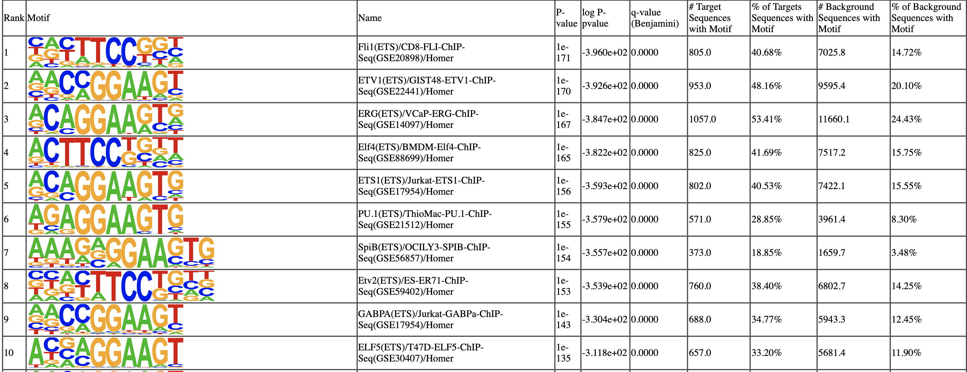
Homer all peaks
1879 more accessible loci
Several ETS transcription factors (includind Pu.1) could bind to the more accessible sites.
ETS TF regulates immune development

Slide 64
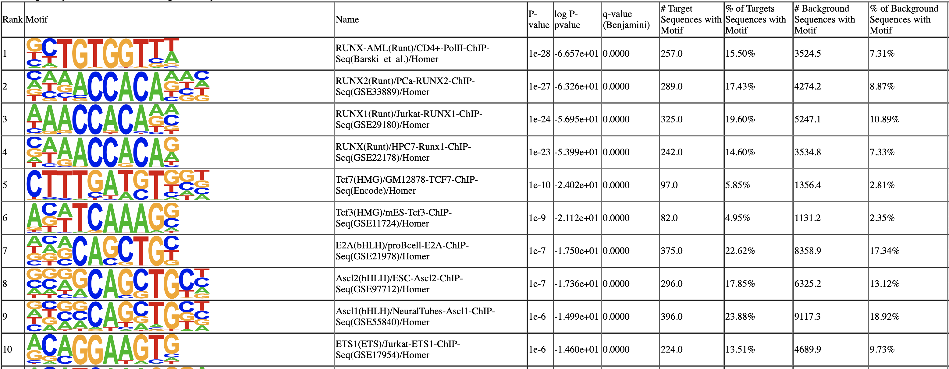
Homer all peaks
1658 less accessible loci
Runx and Tcf7 could bind to the less accessible sites.
Runx1 and Tcf7 are regulators of the Immune development.

Slide 65
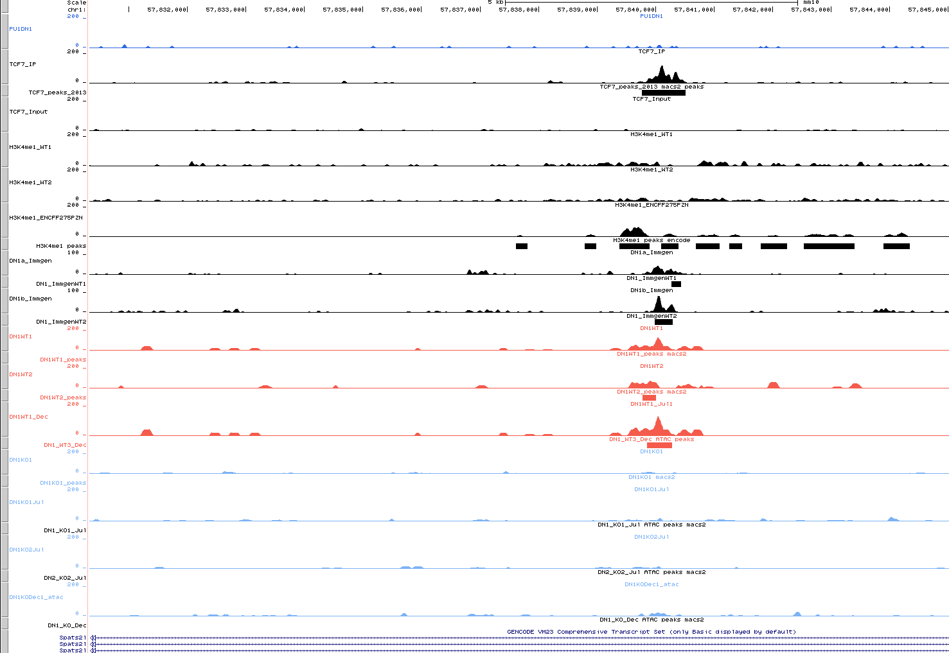

Slide 66
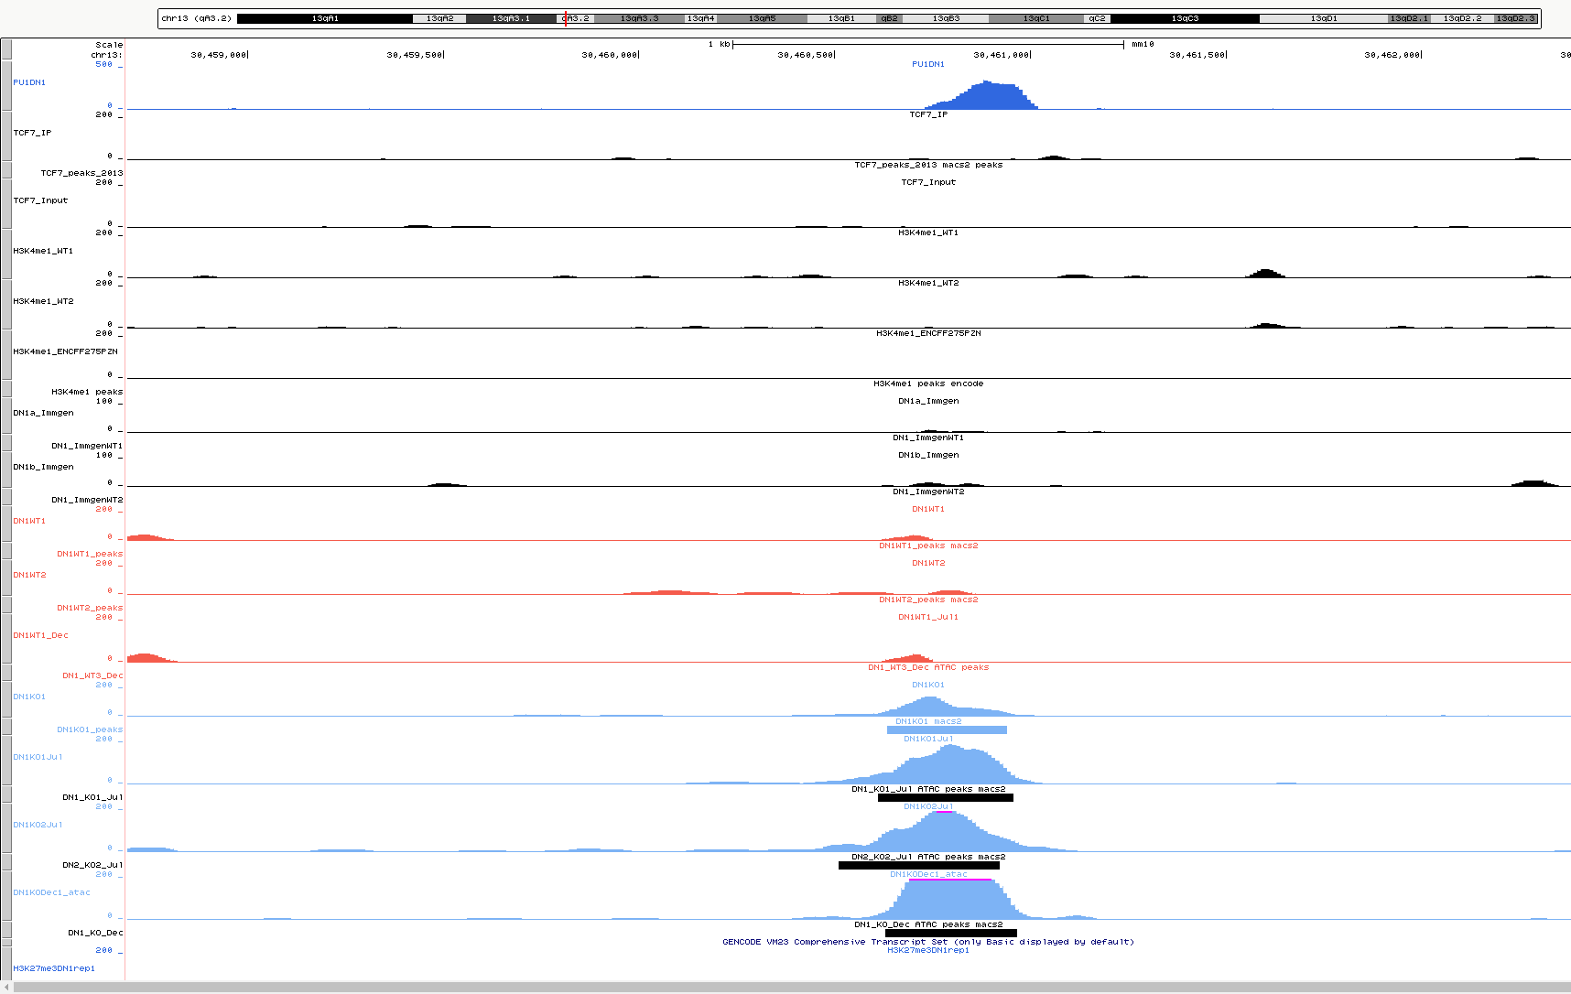

Slide 67
Summary (25/01/22)
MORC3 affects chromatin accessibility at DN1
Accessibility is changed at immune development potential binding sites
What is their effect on development? ➔ Veronica will make a summary of what
Seems that accessibility change might affect enhancer sites (eg. Bcl11b)
We need H3K4me1 in DN1 to validate
Is there a change in the expression of the TF regulators?
RNA-seq on DN1 will gives us this answer.

Slide 68
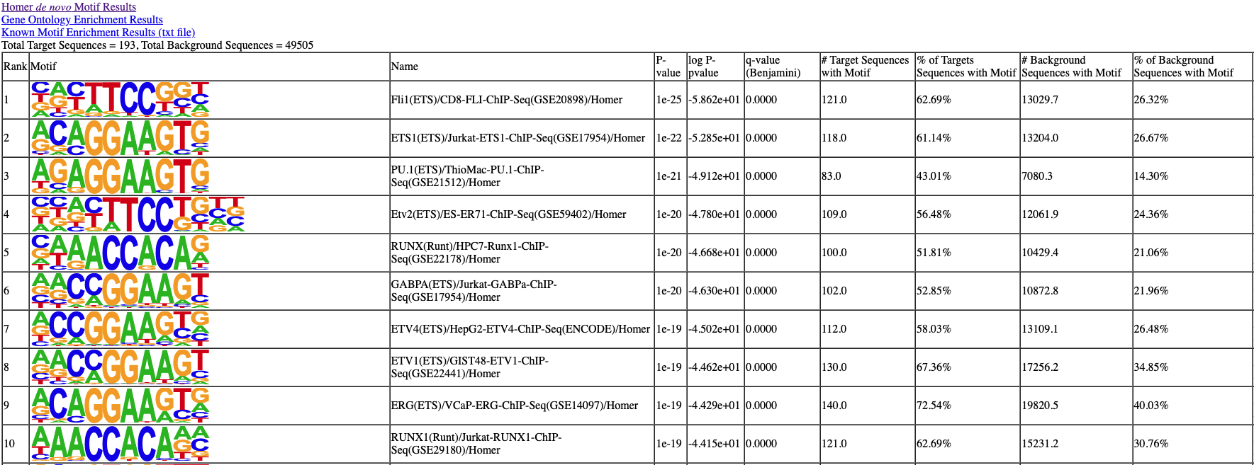
194 more accessible loci
Diffbind

Slide 69
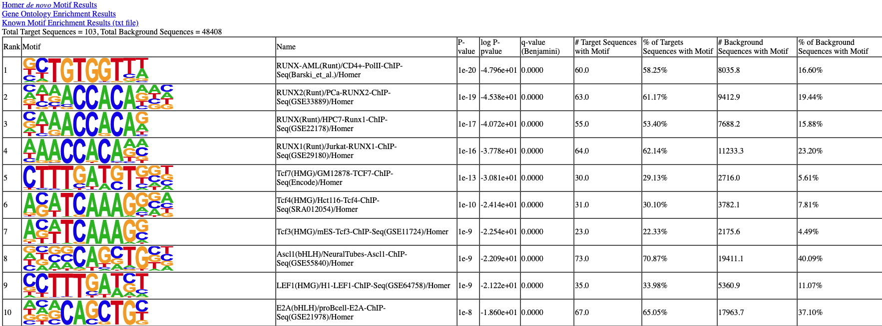
103 less accessible loci
Diffbind

Slide 70
Motifs identified homer differentially accessible loci – consistent peaks

Slide 71
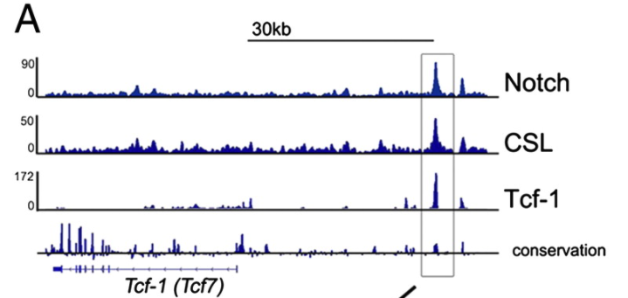
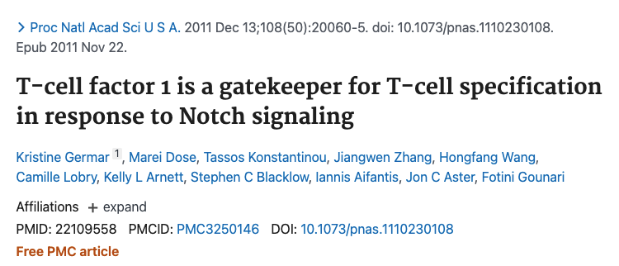
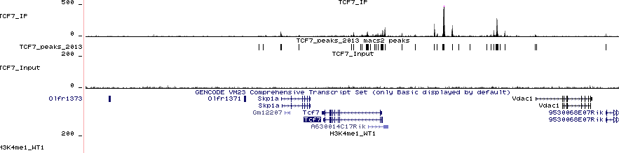
ChIP | peaks
TCF7 | 30527
ChIP performed on primary thymocytes
Has an input sample to normalize

Slide 72
The 34 loci that show less accessibility in MORC3-/-, where TCF7 binds, are mainly intron-distal intergic region?
Are they enhancers?
TCF7 and H3K4me1 are from another tissue.

Slide 73
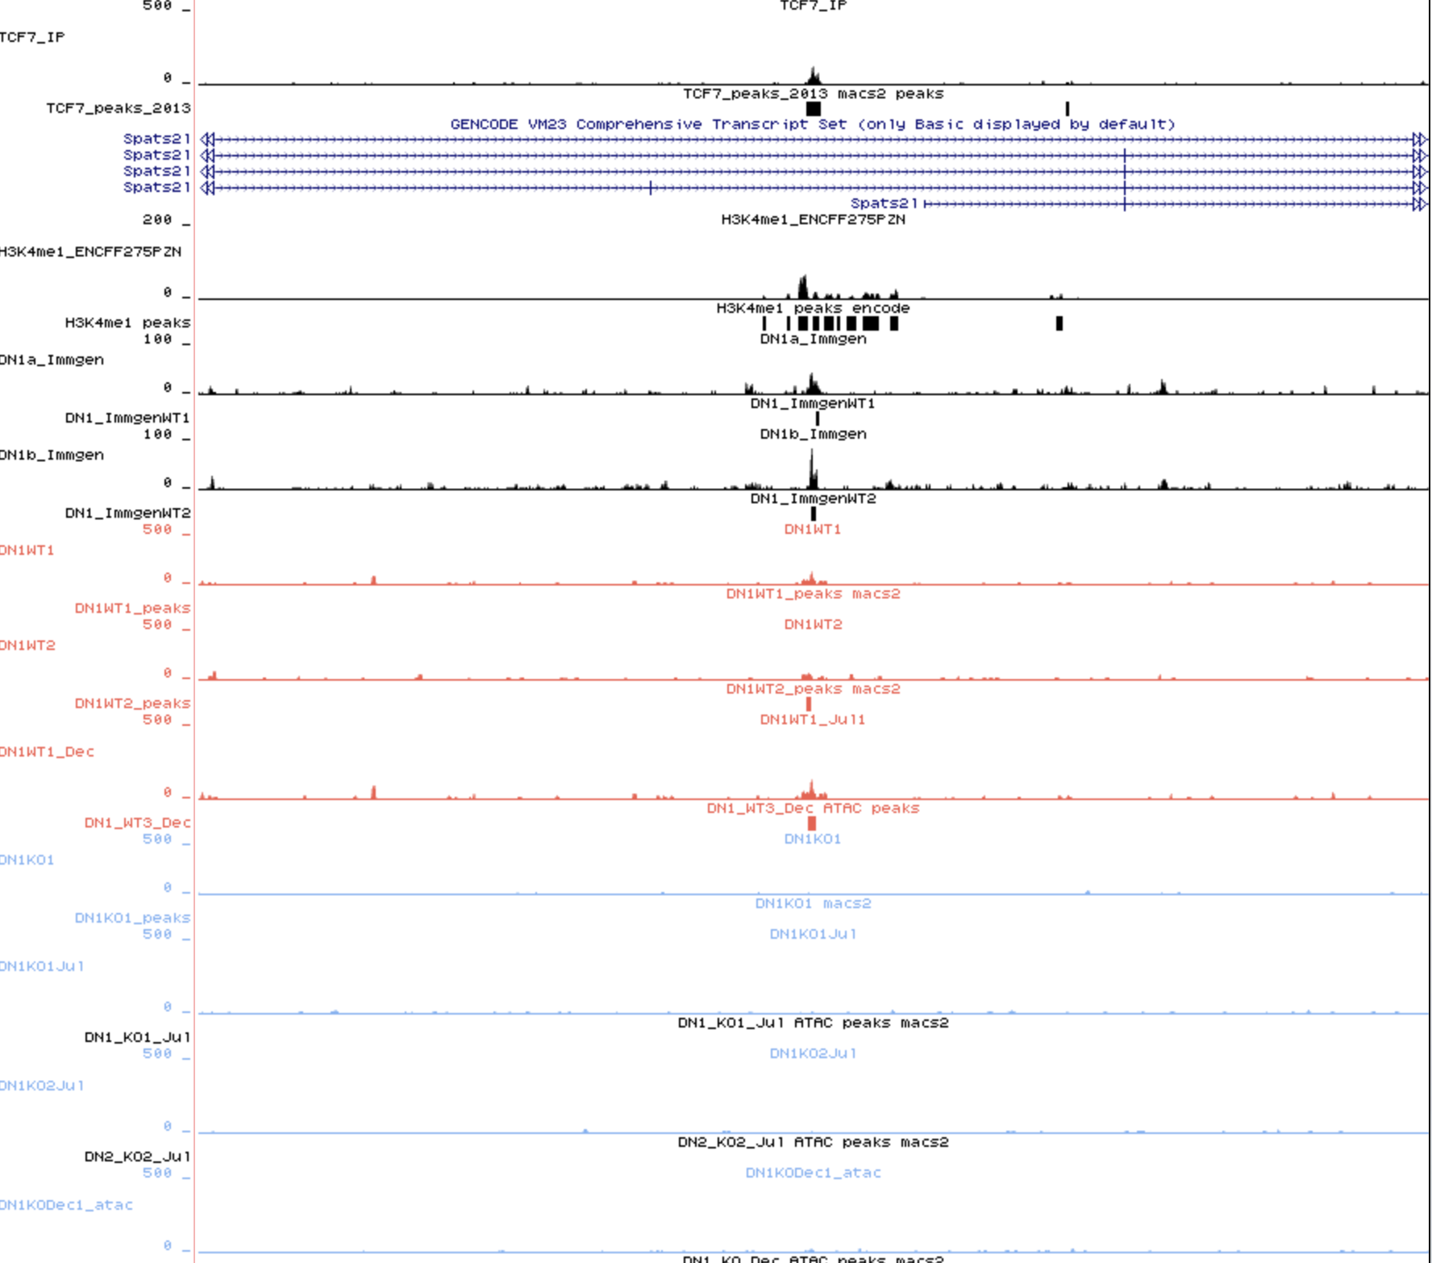
An example of the overlap between TCF7 ChIP-seq and DAL (less accessible)

Slide 74
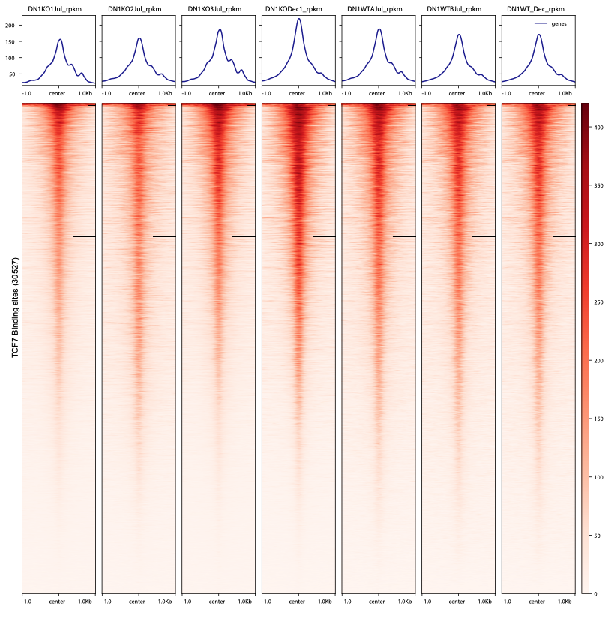
Tcf7

Slide 75
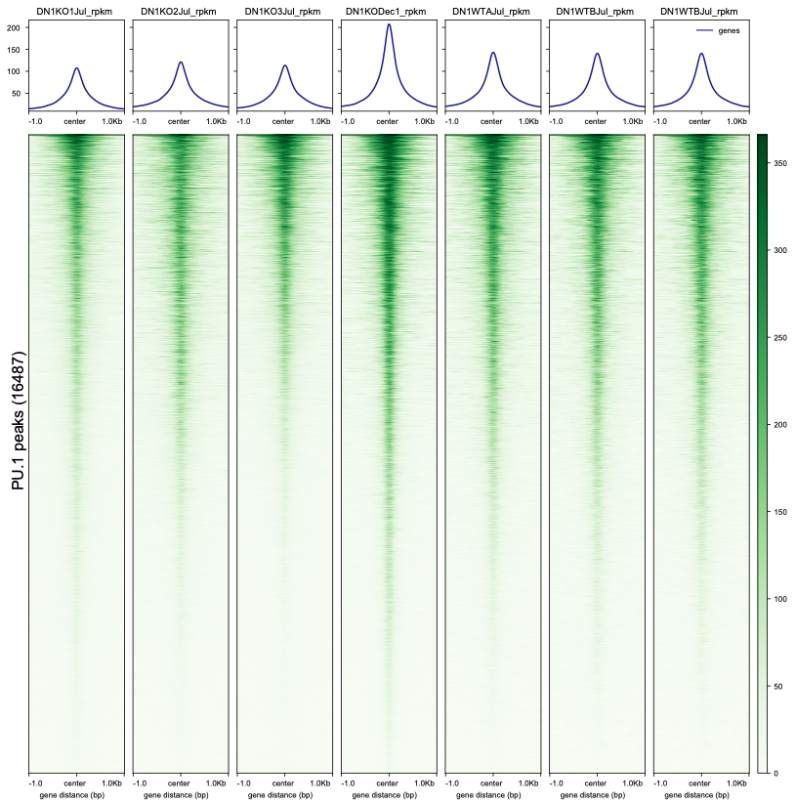
Pu.1

Slide 76
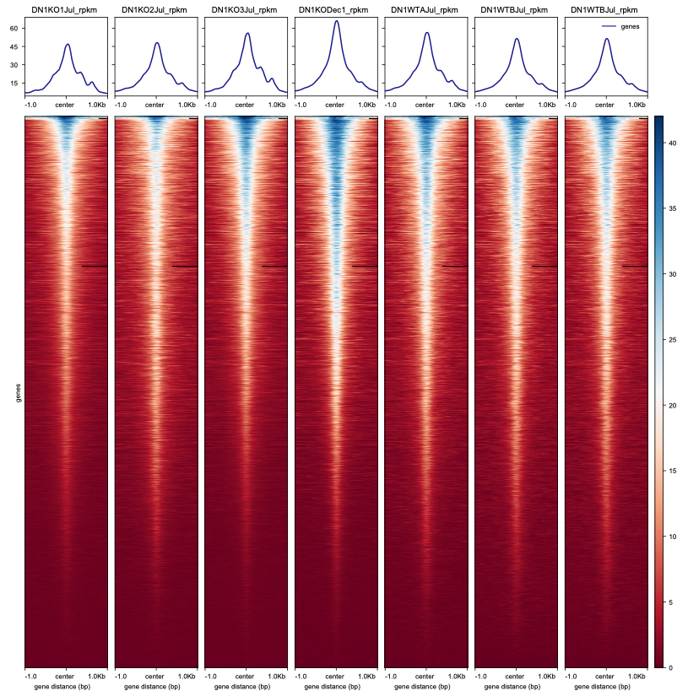
Promoters

Slide 77
PCA plot of the DN1 ATAC-seq data
Based on the read counts in the genome with binSize = 1000bp
There is a lot of variation between the Jul and Dec experiments.
KO Dec and WT Dec are far away.
Replicates of July KO are also spread, 2 are gathered (probably Maja’s experiment) and 1 is separated.
There is a very strong batch effect on the samples.
They do not cluster based on the genotype but more by when the experiment was done and probably also the type of sequencing.

Slide 78
When excluding the DecKO1 sample, we get less more accessible peaks (with all sample it was 1879)
The less accessible sites are not changed much.

Slide 79
More accessible peaks in KO
(1371)
3xWT versus 3xKO
Homer getDifferentialPeaks FC > 4 / p-value <0.05
Less accessible peaks in KO
(1725)

Slide 80
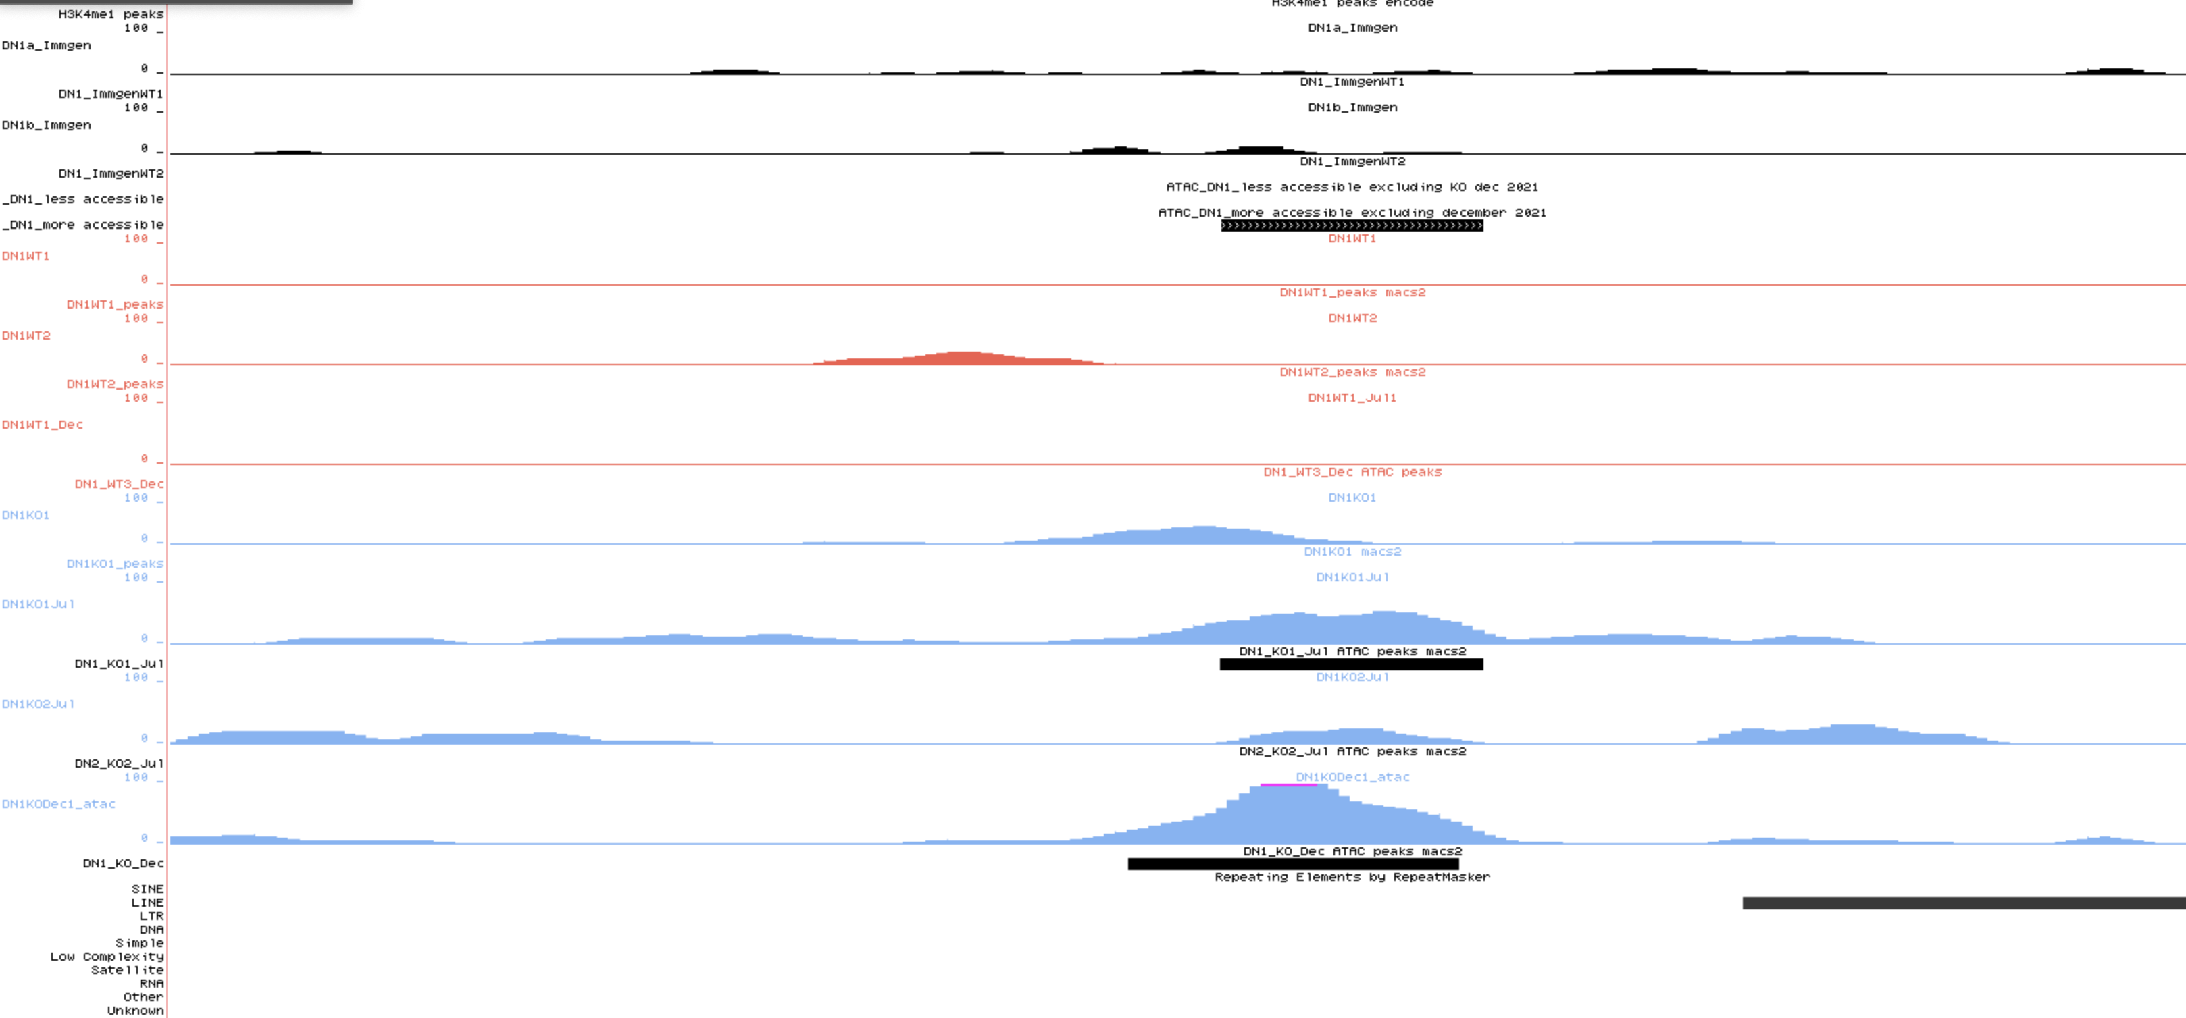

Slide 81
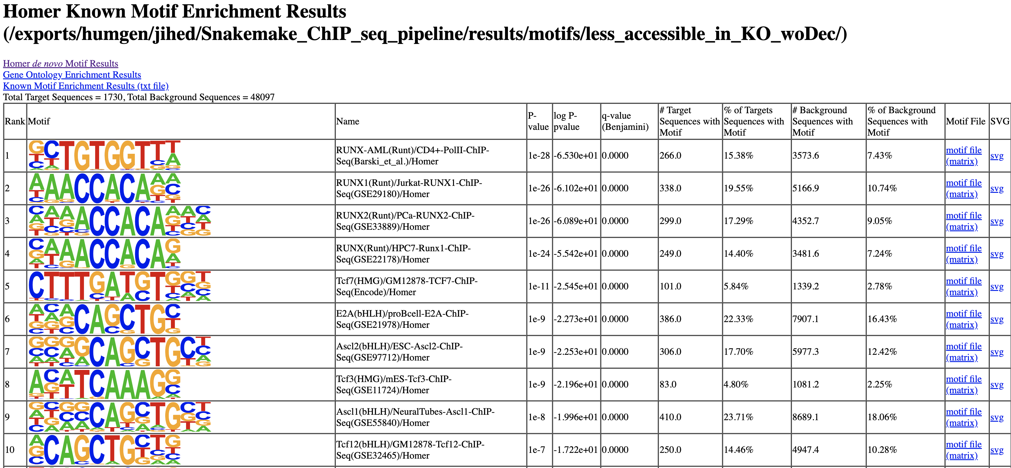
1725 less accessible loci

Slide 82
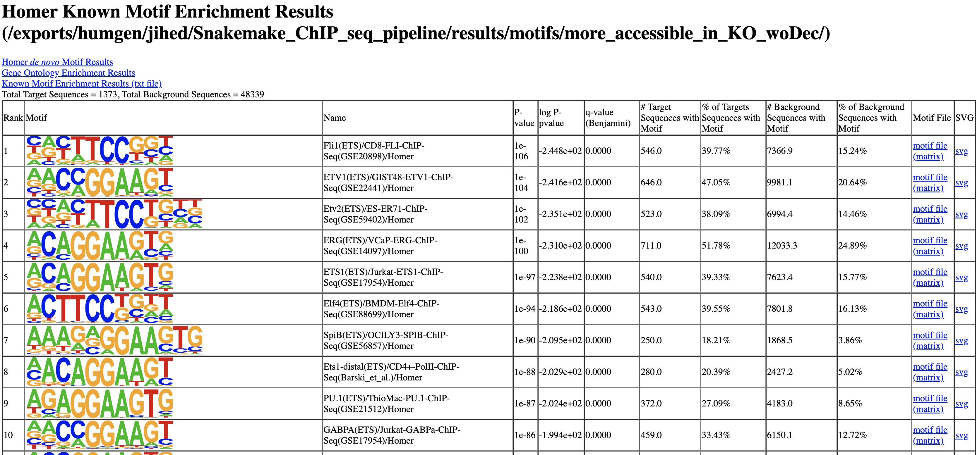
1371 more accessible loci

